Slide 1
Introduktion til Programmering og Problemløsning (PoP)
Jon Sporring
Department of Computer Science
2020/09/16

Slide 2
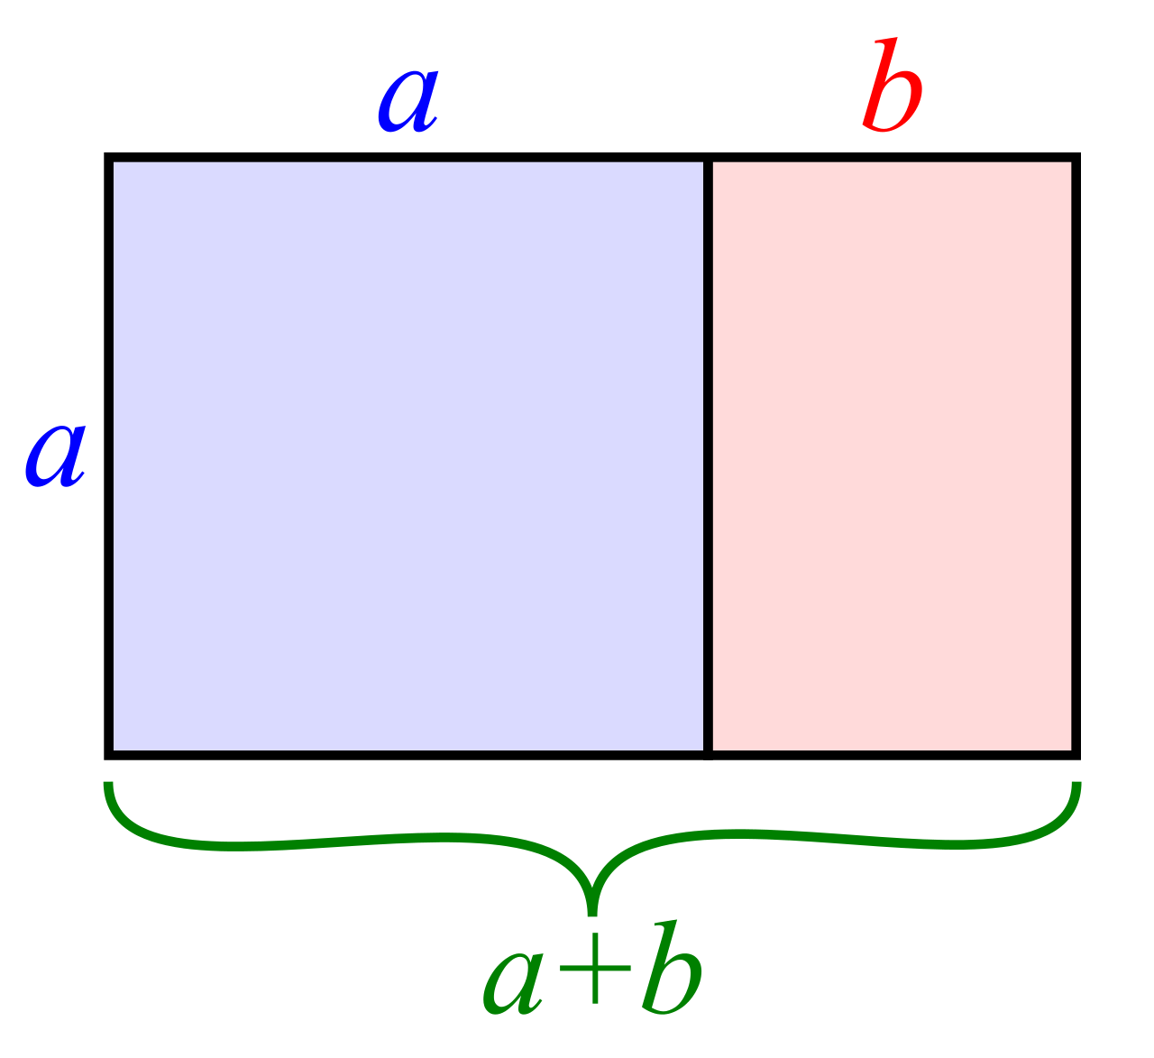
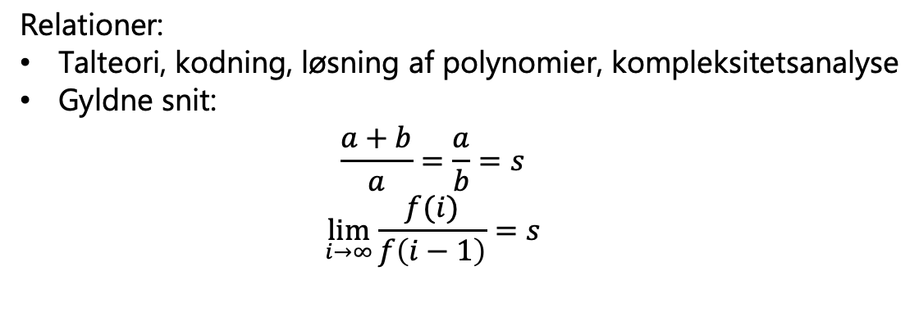
Fibonacci
En talsekvens efter programmet:
f: int -> int
f(0)=0
f(1)=1
f(i) = f(i-1) + f(i-2), i > 1
0, 1, 1, 2, 3, 5, 8, 13, …
Historie:
Pingala (450-200BC)
Leonardo Bonacci (Fibonacci) (1220)
Relationer:
Talteori, kodning, løsning af polynomier, kompleksitetsanalyse
Gyldne snit:
$$\frac{a+b}{a}=\frac{a}{b}=s$$
$$\lim_{i→∞}{\frac{f(i)}{f\left(i−1\right)}}=s$$

Slide 3
Fibonacci
f: int -> int
f(0)=0
f(1)=1
f(i) = f(i-1) + f(i-2), i > 1
0, 1, 1, 2, 3, 5, 8, 13, …
For-løkke
While-løkke
Tupple + for-løkke
let fib n =
if n < 1 then 0
else
let mutable prevPrev = 0
let mutable prev = 1
for i = 2 to n do
let curr = prev + prevPrev
prevPrev <- prev
prev <- curr
prev
let fib n =
if n < 1 then 0
else
let mutable prevPrev = 0
let mutable prev = 1
let mutable i = 2
while i <= n do
let curr = prev + prevPrev
prevPrev <- prev
prev <- curr
i <- i + 1
prev
let fib n =
if n < 1 then 0
else
let mutable prev = (0, 1)
for i = 2 to n do
prev <- (snd prev, (fst prev) + (snd prev))
snd prev

Slide 4
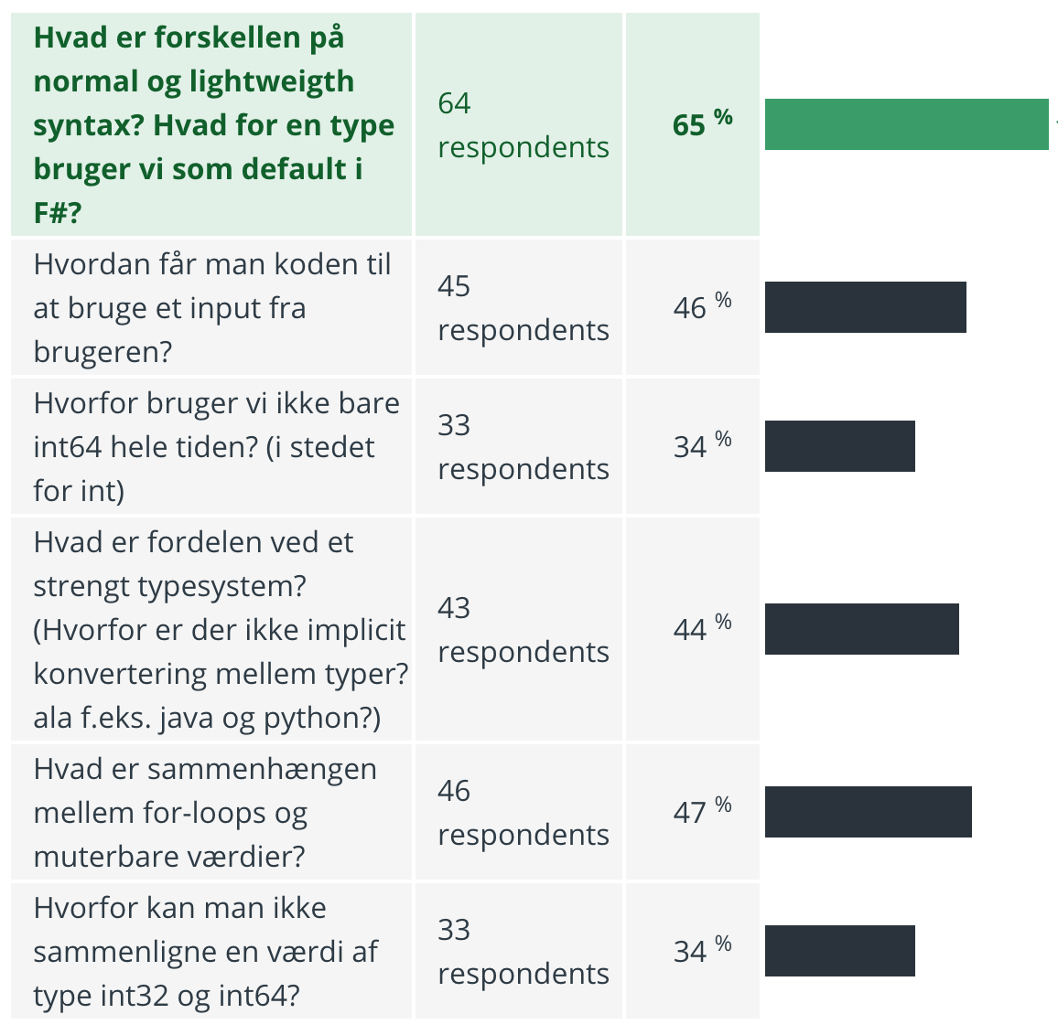
Spørgetime

Slide 5


